Slide 1
Online Safety meeting for parents and carers
Pool Hayes Primary School

Slide 2
What happens in school to protect children?
Range of safeguarding policies including Online Safety and Acceptable use policies
Filtering and monitoring
Online safety lessons as part of the Computing, RHSE and PSHE schemes of work
Lessons equip children to stay safe both now AND in the future
Visiting speakers e.g. PCSOs and E-cadets in every class
Audit by governors/subject leader
Pupil surveys
SMART rules

Slide 3
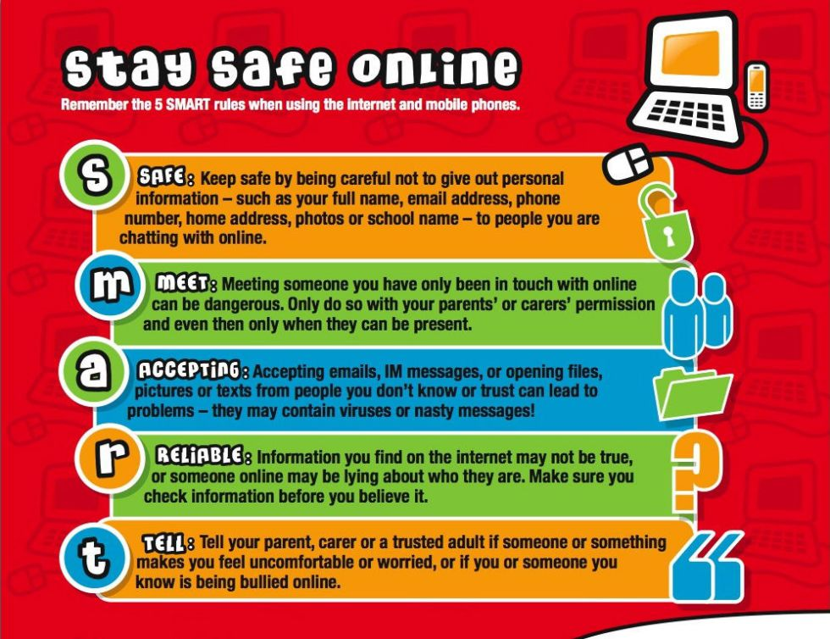

Slide 4
What can parents and carers do?
Decide when your children are ready to first use the internet.
Consider your child’s maturity and that of their peers.
Promote respect for others.
Set clear rules.
Set clear consequences.
Be available to your child if they need to talk to someone. Discuss issues and actions with them openly e.g. cyberbullying – take the problem seriously, assure your child it will stop, record and report it.
Look at useful websites and publications yourself.

Slide 5
What can parents and carers do?
Talk to your children about their online activities. Be aware of their activity with websites, music, games, email, videos, instant messaging.
Become net savvy.
Ask questions about how others behave online – do they encounter children being mean?
Ask them what they should be aware of / wary of.
Give them advice about what to do if they are made unhappy or uncomfortable about something online.
Install / activate filtering and anti-virus software.
Be vigilant and look for mood swings, changes in online activities, changes in attitudes to social activities.

Slide 6
What can parents and carers do?
Useful links:

Slide 7
Online Safety meeting for parents and carers
Pool Hayes Primary School
Thank you for attending this afternoon.

